Slide 1
Why Egeria is an open source project?
John Mertic
Director, ODPi
25 March 2020

Slide 2
A (brief) history of metadata

Slide 3
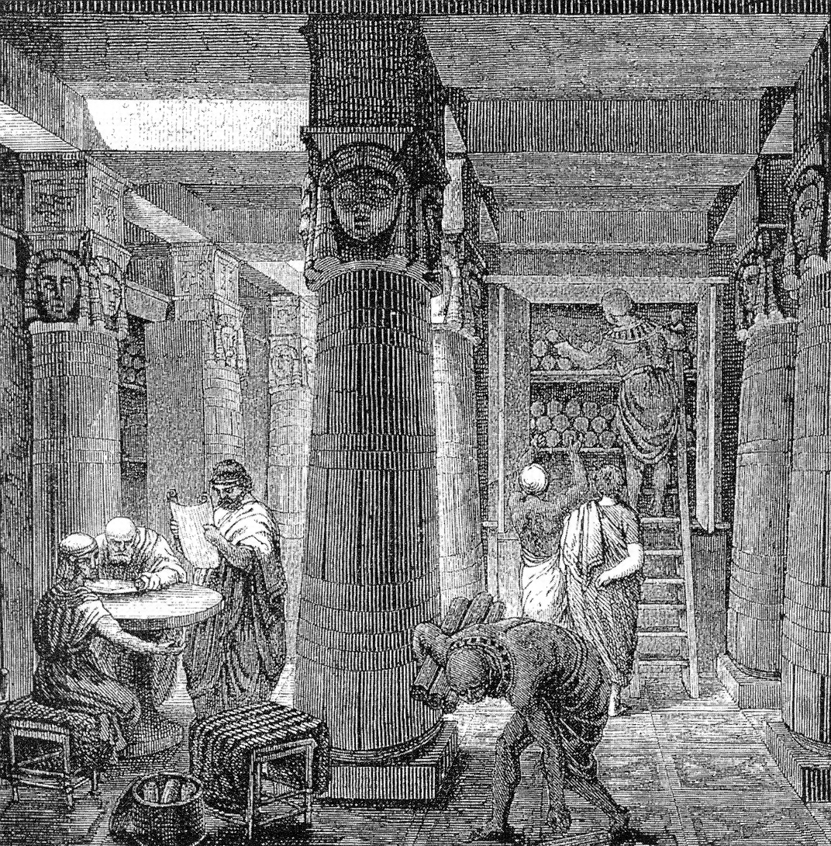
280 BC – The Library of Alexandra attached a small, dangling tag to the end of each individual scroll.
Source: https://www.dataversity.net/a-brief-history-of-metadata/
Image source: https://en.wikipedia.org/wiki/Library_of_Alexandria#/media/File:Ancientlibraryalex.jpg
Notes:
“For example, in 280 BC, the Great Library of Alexandria attached a small, dangling tag to the end of each individual scroll. The tags gave the title, subject, and author, allowing library users to assume the content, without having to unroll each scroll, and so the scrolls could be returned to their proper location. Although librarians of those times did not call the information on the tags “metadata,” this is one of the earliest recorded examples of metadata, and eventually evolved into the card catalogs (another version of metadata), used in libraries a few decades ago.”

Slide 4
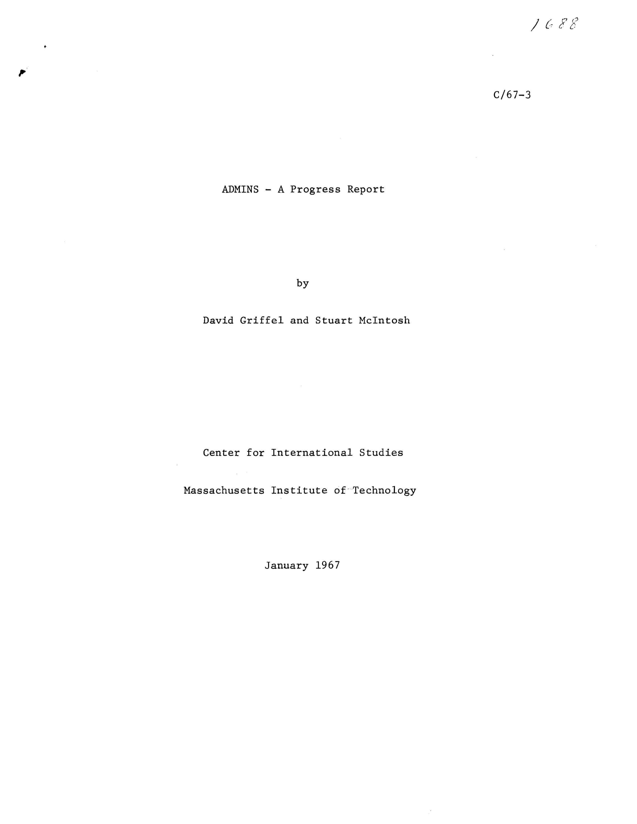
1967 - Stuart McIntosh and David Griffel of MIT are the to first mention metadata for computer systems, as they described the need for a digital “meta language.”
Source: https://dspace.mit.edu/bitstream/handle/1721.1/82974/09487802.pdf

Slide 5
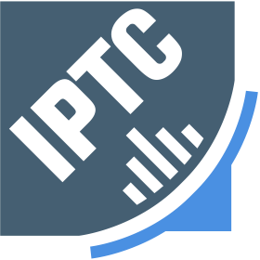



Notes:
In 1979, the International Press Telecommunications Council (IPTC) defined metadata standards and attributes that could be inserted into images.
In 2001, NISO (National Information Standards Organization), which focuses on creating industry standards for the information industry (publishers, libraries, and software developers), decided to get serious about metadata, and published the document, Metadata Made Simpler: A Guide for Libraries.
The Data Documentation Initiative (DDI) is an international standard for describing the data produced by surveys and other observational methods in the social, behavioral, economic, and health sciences. DDI is a free standard that can document and manage different stages in the research data lifecycle, such as conceptualization, collection, processing, distribution, discovery, and archiving. Documenting data with DDI facilitates understanding, interpretation, and use -- by people, software systems, and computer networks. Use DDI to Document, Discover, and Interoperate!
Metadata: Best Practices for Oral History Access and Preservation

Slide 6
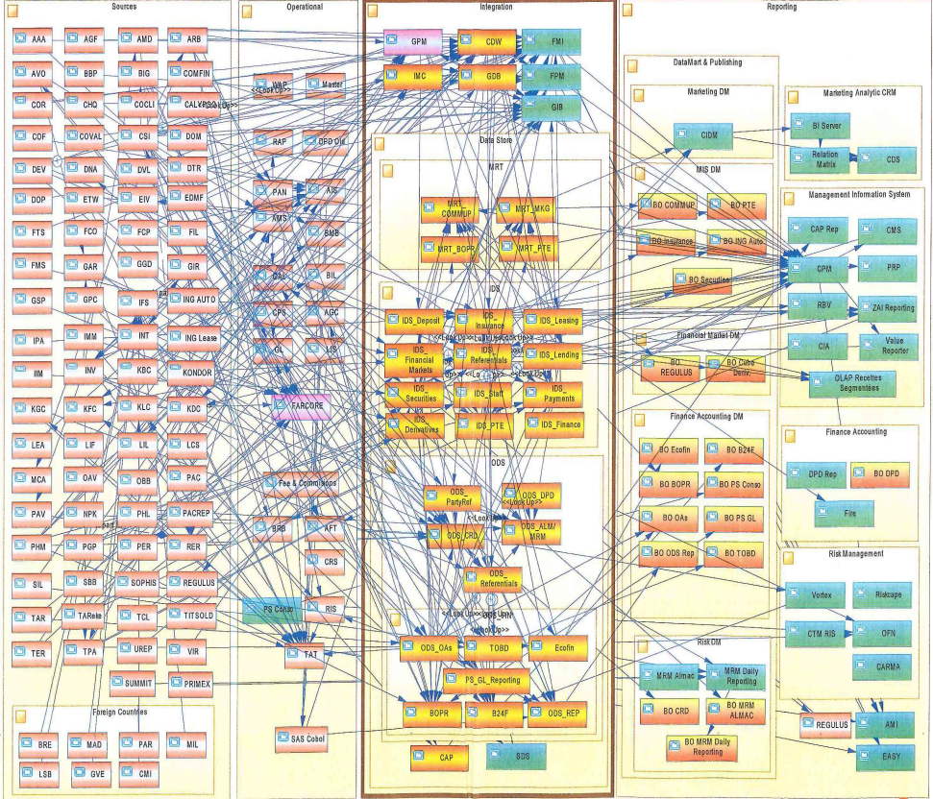
But standards didn’t solve interoperability
Standards were often developed outside of the context of a implementation
Pace of standard development didn’t match pace of software evolution
Enter Open Source!

Slide 7
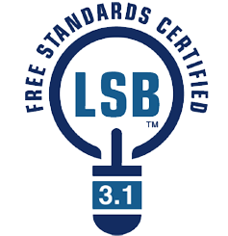


+
=

Slide 8
Open Source brings all constituents to the table

Slide 9
Open Source brings all constituents to the table
Use cases,
Personas,
Practitioners
input
Search
Open Metadata Access Services
Open Metadata Repository Services
Data integration, availability and integrity best practices

Slide 10






Realizing open metadata and governance
Delivering core technology
Recruiting vendors
Assisting practitioners
Core Technology
Vendors
Project
Egeria
Compliance Suite
Practitioners
Best Practices
Project
Data
Governance

